Slide 1
Challenges of Securing Clinical Data in a Cloud-centric World
Patty Furukawa – Assistant Dean for IT
University of California-Irvine School of Law
Doug Edmunds – Assistant Dean for IT
University of North Carolina School of Law

Slide 2
UC Irvine School of Law
Founded in 2009
Clinical program began in Fall 2011
Deployed Time Matters in Spring 2012
Switched to Clio in Fall 2012

Slide 3
Academic Year 2012-2013
5 clinics – “firm” policy for information security
4 clinics – not under our “firm” policy
Approximately 140 students
8 full-time faculty
7 adjunct faculty
1 clinic administrator

Slide 4
UNC School of Law
Founded in 1845
Clinical program optional for 3Ls
Case Master used circa 1999-2005
Time Matters used from 2005 – 2011 (fall)
Clio deployed fall 2011

Slide 5
Academic Year 2012-2013
6 clinics all operating under same “firm” policies
1 center for civil rights, non-clinical, needs vary
Approximately 70 students (only 3Ls)
8 full-time faculty
3 full-time staff

Slide 6
Survey Results
Conducted via Teknoids listserv – May 2013
Responses from most US geographic regions + 1 from Canada
Indicative of hesitation toward a move to the cloud
Concerns mainly about data control
Notes:
DOUG

Slide 7
Notes:
DOUG
**You’ll note here that strong majority still handles clinical data locally
**what was interesting was how responses varied to questions that followed based on the respondent’s answer here
** poll the audience for a show of hands, who’s using what?
** brief discussion of strong players in both cloud and client-server space (TM, Amicus Atttorney, Clio, Rocket Matter)

Slide 8
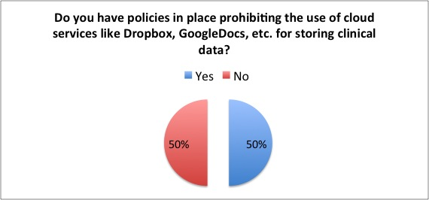
Notes:
DOUG
**clearly there’s an even split here, but worth noting is the fact that some of the respondents who said yes were ones who have, in fact, moved to cloud-based case management platforms
** Patty is going to dive in and break down the responses on the next slide

Slide 9
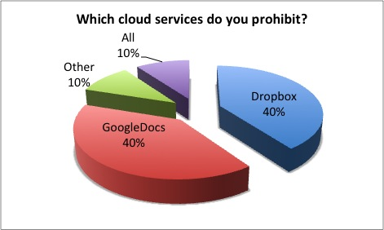
Notes:
PATTY
Trend shows that those that have moved to the cloud are concerned with the use of other cloud product that may not necessarily have been vetted.
**Differentiation between various cloud storage providers is critical!
**Even schools who’ve moved to the cloud have concerns about where people are saving files

Slide 10
Notes:
DOUG
For the “we don’t” respondents, they were ALL schools who still use locally stored data and have not moved to the cloud.
But some local-only providers DO provide in-person training, online documentation and training.
And ALL schools who have moved to the cloud DO provide training and user education.
** the take away here is that training is important, and not just to schools who’ve moved to the cloud
One thing to stress is that if there are institutions that have moved to the cloud, there should be some form of education about risks of accessing data via a browser or a mobile device
Things like:
How shadow copies of files are made upon access
Knowing the full inventory of where your files are in case a device is stolen

Slide 11
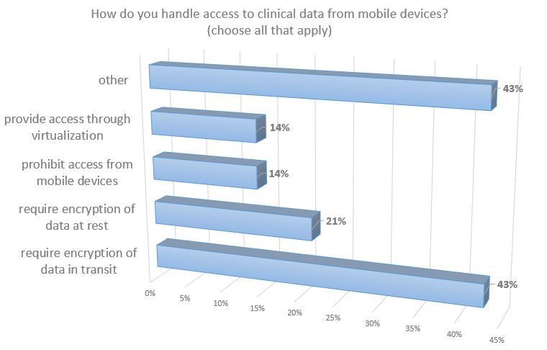
Notes:
DOUG
Regardless of local vs. cloud storage, managing access via mobile devices is something we all struggle with in this age of BYOD
** a number of different approaches to managing this
**talk a bit about our attempts to provide a Citrix desktop with TM in 2010-2011
**talk about TrueCrypt and our process on local data encryption
**talk about inherent lack of security once e-mail leaves one user’s computer; in-transit it’s hard to ensure security →
discuss UNC’s use of Cisco’s IronPort Registered Envelope Service (we host hardware; they house the keys in the cloud)
Of those that responded Other:
**Require a password on device
**Currently the Time Matters server cannot be accessed via mobile devices.
**No policy yet
**Currently using MS SharePoint with SSL encryption (https)
**Only faculty can have access by VPN on their law school computer. It is very slow and restrictive. No access when using phone or other mobile devices. As a result email is overused. Seems both the least secure and piggy.
all mobile devices must have a password

Slide 12
Do you have any formal procedures in place to monitor how clinical data are being stored?
13 out of 14 institutions answered no.
Yes - “We utilize encryption on the server and have full logging turned on for all clinical data.”
No - “We need to develop better policies for monitoring this. Although almost all of our data are stored within Clio, some users are still saving data to their network drive (I recently learned), which is not what we would like.”
Notes:
PATTY
One of the things that the survey shows is that many of us do not have formal procedures in place for monitoring how clinical data is being stored.
Once an institution moves to the cloud, some of the logging tools that you are used to using are no longer available.
**local logging tools are more readily available when storing locally
The reason for the monitoring is because people are using other convenient methods of file storage that may not necessarily be secure.
And going back to the previous point that once you moved to the cloud, people don’t differentiate between various cloud services that are okay to use.
There are some cloud solutions that are a good alternative to some of the popular services like DropBox that can offer plug-ins that allow for secure file storage and tracking.
Watchdox is one tool that I have read on teknoids that some institutions were looking at:
through the tool the author of a document can control access to the document by limiting or permitting: print, edit, copy-paste, whether or not it can be downloaded, a watermark of the person accessing it can be added so a photo of the document cannot be taken, etc. Access permissions can also be set to expire after a specified period of time.
Has logging capability of who accessed, printed, edited, etc. and even what device accessed the document
As a recipient of a protected watchdox document, you can access it using a web browser, a MS Windows based plug-in for the desktop, or an app supported on the Apple iOS, RIM’s Blackberry, and Google’s android devices.
They have various deployment options: public cloud, private cloud, or on-premise appliance.
Citrix ShareFile is also another product that one institution was looking at – the ShareFile Sync tool is similar to dropbox but allows more control of the files that are shared and can provide secure email links to files.
----- Meeting Notes (6/10/13 16:09) -----
Doug will add some re: the center for civil rights

Slide 13
What types of tools, if any does your IT unit provide and support to help secure clinical information? (institutions w/ local storage)
Main campus ITS Security department
Time Matters passwords & port limitation
Documentation on disk encryption
Limiting access to clinical data only to workstations in the clinic
Strict e-mail policies
VPN for faculty
Separate server for clinical data
Notes:
PATTY
** point to stress here is that those with local storage have a much more controlled environment when it comes to securing their clinical information(actual
(actual responses below)
rely on the University’s ITS Security department
Time Matters password protection and limiting ports on the TM servers
Documentation on disk encryption for Macs
Documentation on TrueCrypt for Windows
Limit workstations within clinic to access the clinical data
Remote users must use encrypted VPN to RDP into a workstation
Email policy
VPN for faculty with data on a separate server

Slide 14
What types of tools, if any does your IT unit provide and support to help secure clinical information? (institutions w/ cloud storage)
Encryption (flash drives, laptop HDs)
Password protection (at file level)
Data scanning software
DLP (data loss prevention) through McAfee
Virtualization (Citrix)
Secure e-mail through middleware
Logoff script to remove temp files
Notes:
DOUG
**already covered some of these points on the mobile device slide
**Patty talked about Watchdox and Citrix ShareFile for access and data scanning; I talked about TrueCrypt for encryption
** take some time discussing logoff scripts for Windows and Macs
Encrypt faculty laptops
Data scanning software / VPN
Citrix infrastructure for remote access
Assistance on encrypting documents or jump drives
DLP (data loss prevention) through McAfee (EPO = E-policy orchestrator)
Virtual desktops
Case management tool on cloud’s secure e-mail functionality
Encrypted flash drives
Logoff script to remove temp files opened on the browser or in email
Middleware email platform for sending secure messages
** For those that have moved to the cloud, concern shifts from locally stored data that is in a controlled environment to other devices where people may be accessing this sensitive information.

Slide 15
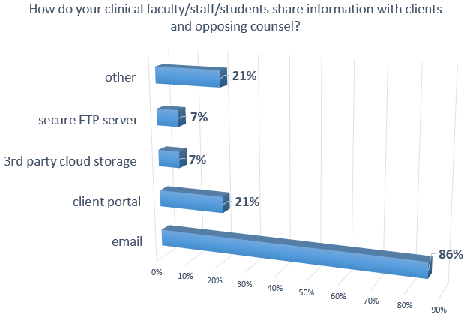
Notes:
PATTY
And this concern about securing clinical information extends to how data is shared with external groups such as your client and opposing counsel.
This slide shows that the majority simply use email which is a very non-secure method of sending information:
- There's no guarantee email goes to it's intended recipient(s).
- Passwords are weak and accounts get compromised.
- By design, email servers can be accessed from the world.
- SSL only encrypts between the receiving end and the server. Email is not encrypted on the server, it's not encrypted in transit between servers, and it's not encrypted at the end point.
So, some of the tools mentioned before like watchdox or sharefile may be a good alternative to sharing files with outside resources.
Or some cloud provided solutions have ways to send via email a web address to the secured content and the person would have to login to get the information.

Slide 16
Information Security Topics
Organizational and personal risks
Stolen credentials (phishing attempts, malware)
Socially engineered threats
Mobile devices
Physical security
Cloud services
Notes:
PATTY
As we move more and more data to the cloud, faculty and students need to be aware that storing sensitive information wherever they feel is convenient is not necessarily the right thing to do.
Explain what it would mean if clinical information was lost – to you as the attorney, to the firm or organization that you work for, etc.
Make users aware of various attempts at stealing ones credentials (it doesn’t matter how many technical defenses are in place if someone’s credentials are stolen)
Make users aware of various socially engineered threats to get at information – it’s not just electronic data that people are after, they can get it by simply calling, asking, or overhearing conversations
Make users aware of the risk of using mobile devices – password protect all of your mobile devices that access clinical information, install remote wipe capability when possible – get rid of data that is no longer in use. Keep definitive copies in secure locations. Encrypt when you can.
Make users aware of physical security – don’t leave laptops on the front seat of cars, be aware of where your physical files, don’t leave case information on white boards in shared conference rooms, etc.
Strongly recommend that users use different passwords for different services
Educate users about the use of cloud services and what that means:
Who has access to your data?
Is your data stored in the U.S.?
Does the company provide a stronger security or privacy policy than “we take this seriously”?
Is your ease of access and collaboration limited to you and your colleagues or is it easier for unwanted parties too?
Once something is posted, it is almost impossible to “take back” or remove information.
There is no guarantee that deleted content or accounts will really be deleted
If a subpoena, search warrant or other legal instrument is presented to the company to obtain information about you, you should not expect to be informed.

Slide 17
Best Practices
Not all cloud-providers are created equal – differentiation is crucial!
Educate your users on the various risks
Develop written SOP and security policies
Involve your university counsel and security officers
Carefully review SLAs and contracts
Backup your data
Notes:
DOUG
**inherent differences between DropBox and a vendor like NetDocuments or Watchdox
** users won’t differentiate themselves, most likely; education is key!
** having written policies protects you and your IT department…but also the users (clinical services may be offered free of charge, but clients still expect the same level of client-attorney privilege and basic protection of their private data)
**trying to go it alone or going rogue is a bad idea!
**even if you’re not an attorney yourself, you need to take ownership and read all SLAs and contracts carefully yourself; look for the following:
SAS70 data center certification
geo-location
first notice clause for subpoenas
some guarantee of data recovery
clarification that your organization owns the data

Slide 18
References & Resources
Cisco IronPort (secure e-mail) – http://tinyurl.com/n99l36p
Watchdox - http://www2.watchdox.com/
Citrix ShareFile – http://www.sharefile.com
Apple Forum (scripting temp file removal) – http://tinyurl.com/l8vk7pg
Notes:
DOUG

Slide 19
Questions?
Doug Edmunds edmunds@unc.edu
Patty Furukawa pfurukawa@law.uci.edu
Notes:
DOUG and PATTY

